Slide 1
Mark A. Martin
Veteran and Military Outreach Coordinator
Brain Injury Alliance of Kentucky
Mark.Martin@Biak.us

Slide 2
Why are Veterans health issues different than the general population?

Slide 3
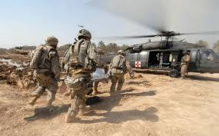
Perspective
During the Revolutionary War there were 1.4 "nonmortal" wounded for every soldier killed in combat. That ratio rose to 2.3 in World War II and 2.6 in Vietnam. The ratio more than tripled in Iraq and Afghanistan, where there are more than seven wounded survivors for every soldier killed.
Some 633,000 veterans -- one out of every four of the 2.3 million who served in Iraq and Afghanistan -- have a service-connected disability, according to the Bureau of Labor Statistics.

Slide 4
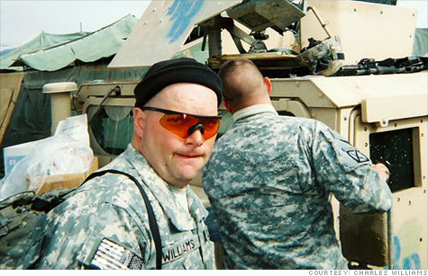
Rate of Traumatic Brain Injury
The total diagnosed number of traumatic brain injury (TBI) cases from 2000 – 2012 was 266,810 Service Members of which 58% was U.S. Army Soldiers. Traumatic events may simultaneously cause TBI and post-traumatic stress disorder (PTSD), with many symptoms overlapping that require extensive medical, therapeutic and rehabilitation services to maximize overall function and independence.

Slide 5
Iraq and Afghanistan Presumptive Illnesses
Brucellosis
campylobacter jejuni
coxiella burnetii (Q fever)
Malaria
Mycobacterium tuberculosis
nontyphoid Salmonella
Shigella
Visceral leishmaniasis
West Nile Virus

Slide 6
Gulf War Presumptive Illnesses
Undiagnosed illnesses. These are illnesses that may include but are not limited to: abnormal weight loss, fatigue, cardiovascular disease, muscle and joint pain, headache, menstrual disorders, neurological and psychological problems, skin conditions, respiratory disorders, and sleep disturbances.
Functional gastrointestinal disorders. Functional gastrointestinal disorders are a group of conditions characterized by chronic or recurrent symptoms that are unexplained. These disorders may include but are not limited to irritable bowel syndrome, functional dyspesia, functional vomiting, functional constipation, functional bloating, functional abdominal pain syndrome, and functional dysphagia.
Chronic Fatigue Syndrome
Fibromyalgia

Slide 7
Vietnam War Presumptive Illnesses
AL Amyloidosis
Chronic B-cell Leukemias
Chloracne
Diabetes Mellitus Type 2
Hodgkin’s Disease
Ischemic Heart Disease
Multiple Myeloma
Non-Hodgkin’s Lymphoma
Parkinson’s Disease
Peripheral Neuropathy, Early-Onset
Porphyria Cutanea Tarda
Prostate Cancer
Respiratory Cancers
Cancers of the lung, larynx, trachea, and bronchus
Soft Tissue Sarcomas (other than osteosarcoma, chondrosarcoma, Kaposi’s sarcoma, or mesothelioma)

Slide 8
The Veterans Administration
The largest department is the Department of Defense with about 670,000 employees. The magnitude and importance of national defense is even further underscored by the fact that the next largest department is the Department of Veterans Affairs with nearly 236,000 employees.
The VA’s three areas
Health Care
Benefits
Burial

Slide 9
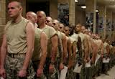
Frustration
Delays
As of Veterans Day 2013, 401,000 claims remained officially backlogged, meaning that the applicants have been waiting at least four months — the agency’s target for the maximum allowable delay
Errors
But according to audits by the department's inspector general, VA has a persistently high error rate with those complex claims. In one category the IG examined, Traumatic Brain Injury claims, VA personnel made errors in 31 percent of cases in 2011.
In response, VA made some changes to its quality assurance process. But during a follow up inspection during 2012, the error rate was still 29 percent.

Slide 10
Still other Frustrations
Veterans' Unemployment Edges Down but Still High
WASHINGTON March 20, 2014 (AP)
Beyond the frustrations of the VA Veterans have a higher rate of unemployment. New Labor Department figures show the unemployment rate for working-age veterans who served on active duty in the U.S. armed forces since September 2001 edged down slightly in 2013, to 9.0 percent. But Thursday's report also found that the rate remained well above the overall civilian unemployment figure of 6.7 percent.

Slide 11
Recap
More than 266,000 Veterans have TBI
Many will have PTSD
Most will have some other service related disability
Greater than 4 month wait, sometimes more than a year wait to receive
Compensation and pension assistance. (Which is often wrong and low)
A harder time than most finding employment

Slide 12
The suicide rate among veterans remains well above that for the general population, with roughly 22 former servicemen and women committing suicide every day.
As of January 10, 2014

Slide 13
22 Veterans per day is a very accurate number, this number comes from the VA Burial section.
22 Veterans per day is probably an under estimation, because only 55% of Iraq and Afghanistan veterans are enrolled in VA.
While older veterans saw a slight decrease in suicides, male veterans under 30 saw a 44 percent increase in the rate of suicides. That’s roughly two young veterans a day who take their own life, most just a few years after leaving the service.
The annual suicide rate among veterans is about 30 for every 100,000 of the population, compared to a civilian rate of about 14 per 100,000.
Nearly one in every five suicides nationally is a veteran — 18 to 20 percent annually — compared with Census data that shows veterans make up about 10 percent of the U.S. adult population.

Slide 14
Things that we do to help
Employment Resource Room
Print and Internet Resources
Garden Program

Slide 15
Resource Room
Working in cooperation with VA’s Compensated Work Therapy Program (CWT), BIAK has room dedicated so that Veterans and others with TBI who are seeking employment, but lack resources can come and search for a job.
The Resource Room provides a quiet secure environment for the veterans to fill out applications on-line, create a resume, and search for work.
In addition we provide USB drives and portfolios to help the job seeker, when they leave our office.

Slide 16
Garden Program
Three categories of Gardens
Independent
Dependent
Fort Knox
The following community partners have made the Garden Program possible:
Agrability, Jefferson County Cooperative Extension, Hardin County Cooperative Extension, Bullitt County Cooperative Extension, Mason County Cooperative Extension, Farm Bureau, University of Kentucky Horticulture Club, Kentucky State University, Fort Knox Military Reservation, Veterans Administration Mental Health Intensive Case Management, and Metropolitan Sewer District.

Slide 17
Independent
Just as the title indicates this part of the Garden Program is independent.
Jefferson County Cooperative Extension has donated plot fees and gardening classes to any veteran that wants to have space in one several community gardens.

Slide 18
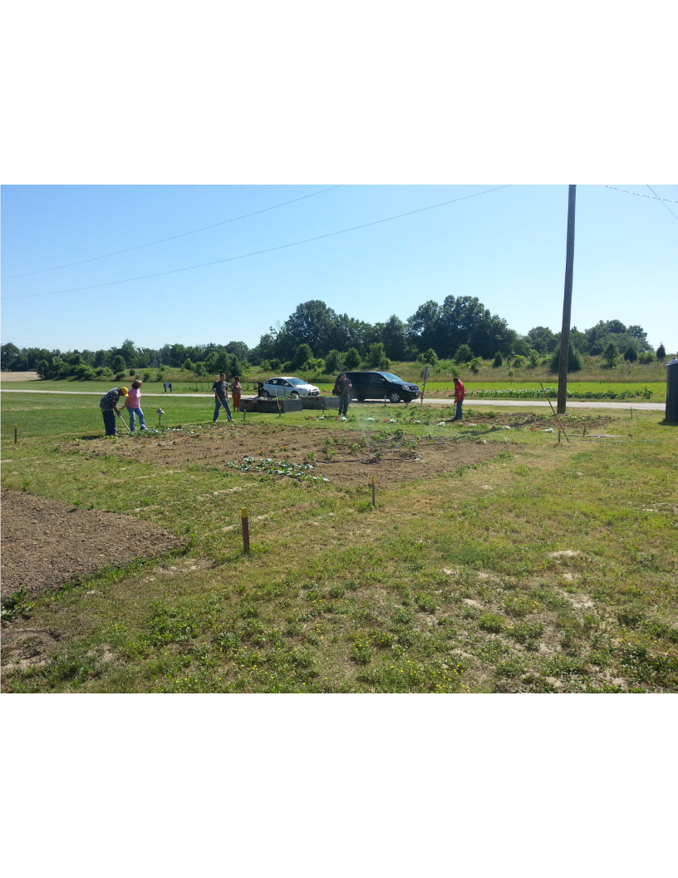
Dependent
Jefferson County Cooperative Extension has given BIAK space in the community garden for VA Mental Health Intensive Case Management (MHICM). The space provides an outlet for some veterans who are too disabled to effectively manage their own affairs. It helps combat depression and draws new veterans into an alternative space that might need assistance. Another critical function of the garden is that it provides care-giver respite, it is vital that caregivers have a break from their responsibilities, the garden at Farnsley-Moorman provides a 5 hour break every week during the season to those caregivers

Slide 19
Elements of the Farnsley-Moorman Garden
Shade
Water
Bathroom
Tools
Transportation
(Not self-directed)

Slide 20
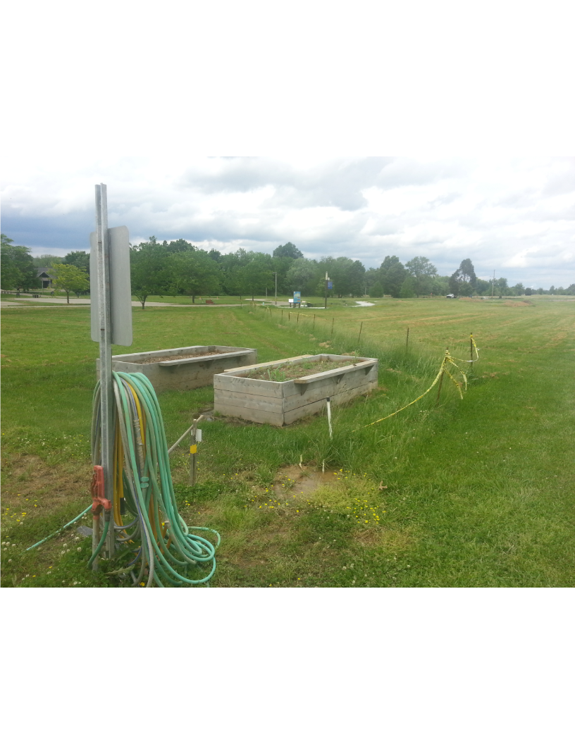

Slide 21
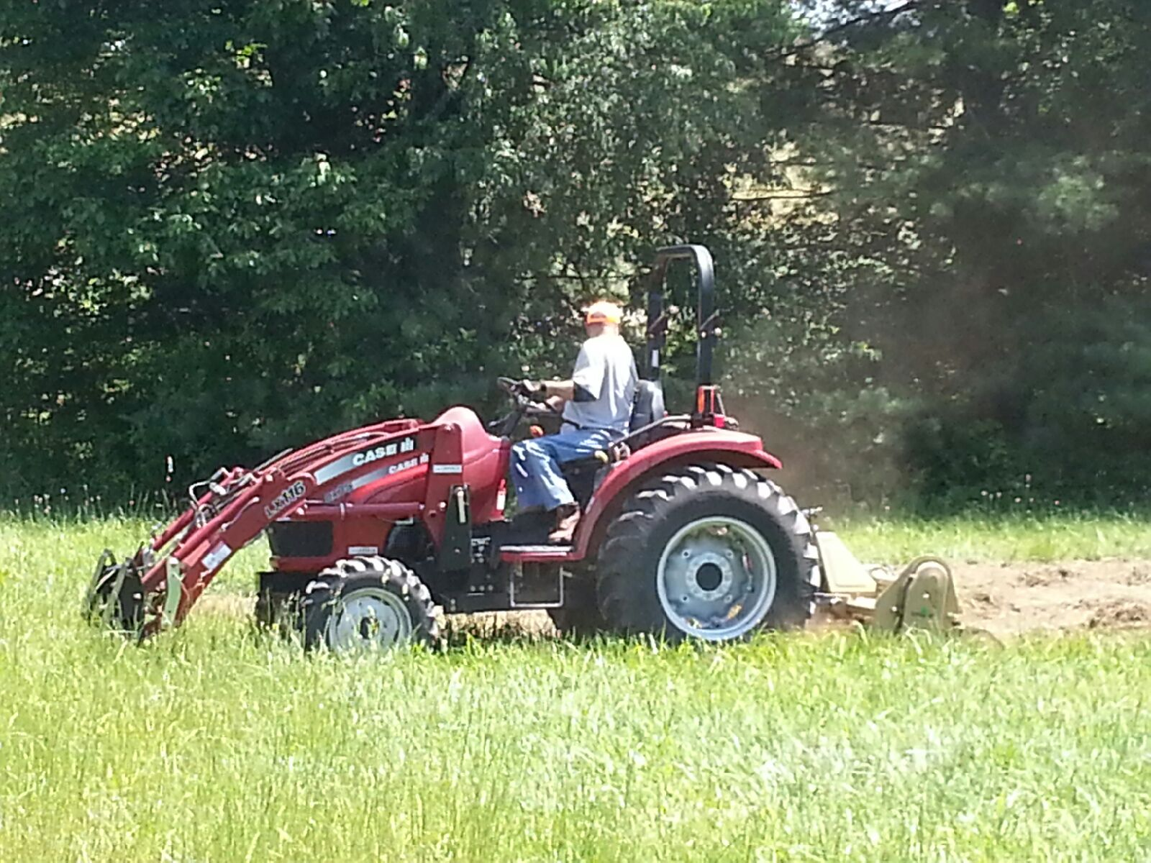
Fort Knox Wellness Garden
The Wellness Garden is unique because it is a self-directed learning environment.
The garden incorporates all elements of the Master Gardener curriculum, it is essentially and large laboratory where the soldiers can learn about gardening.
It has all of the same elements of the garden at Farnsley-Moorman.

Slide 22
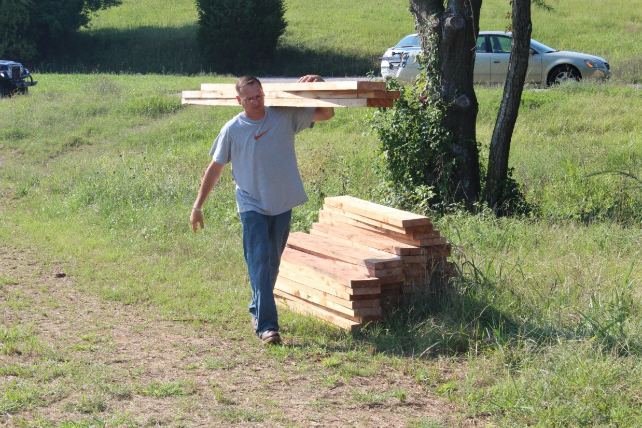
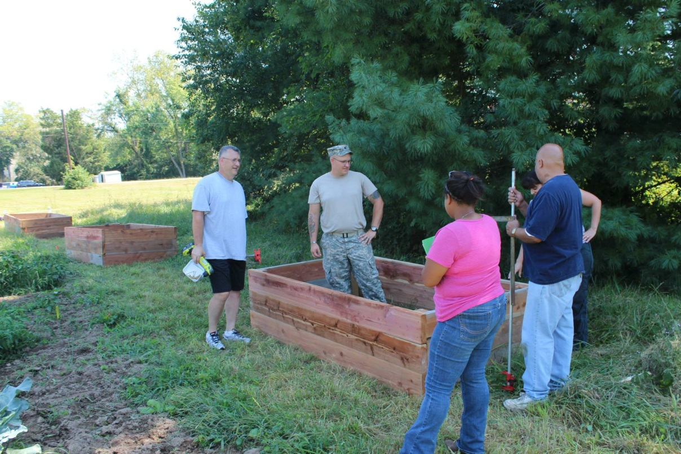
Building Raised Beds

Slide 23
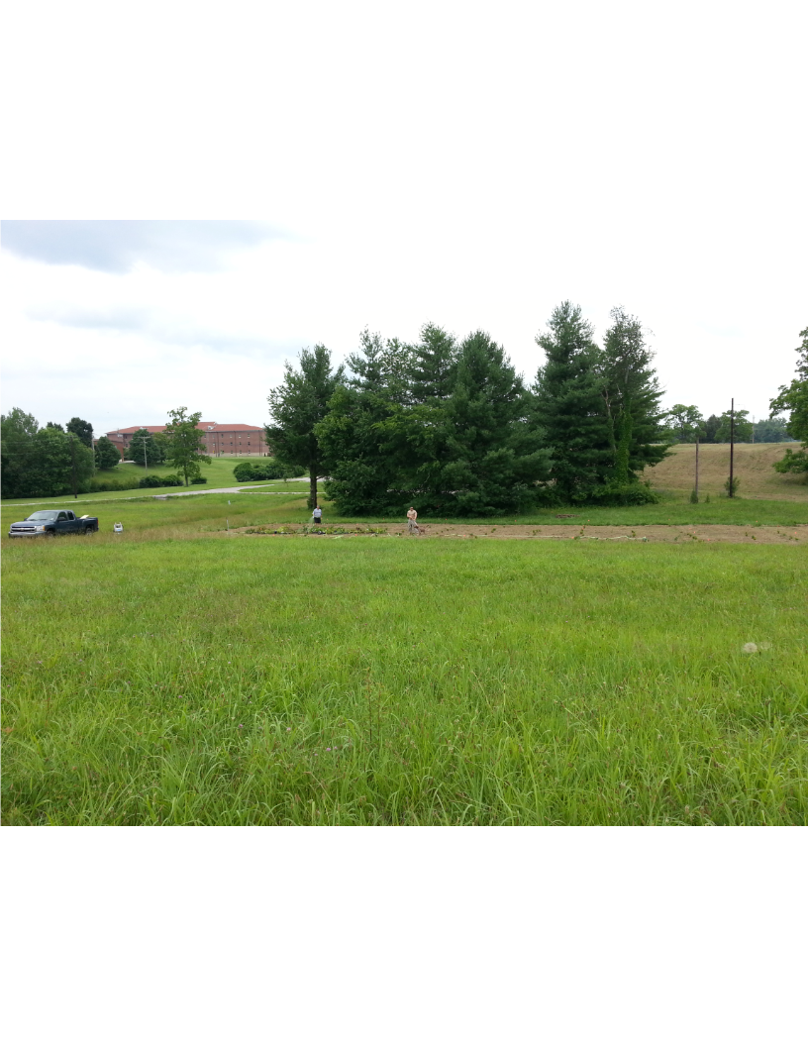

Slide 24
Thank you.
Conclusion:
Whether the TBI survivor is a veteran or not, it is our goal to provide a positive atmosphere to help with recovery.

